Slide 1
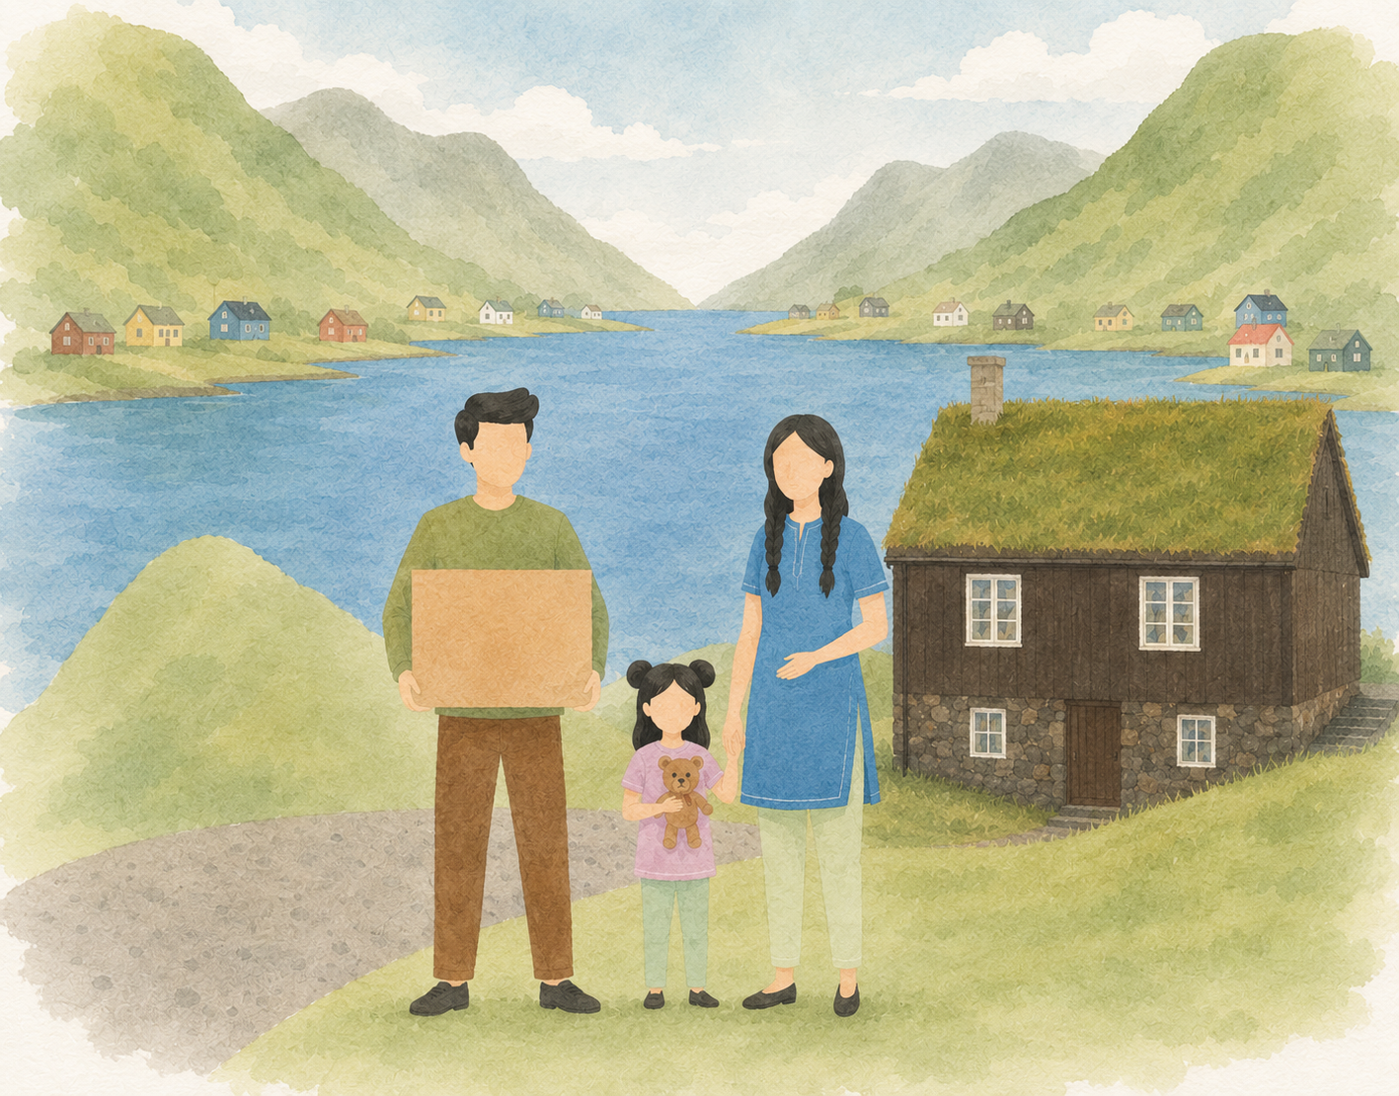

Set títt logo/ búmerki her
Welcome to the Faroe Islands
In cooperation with

Slide 2
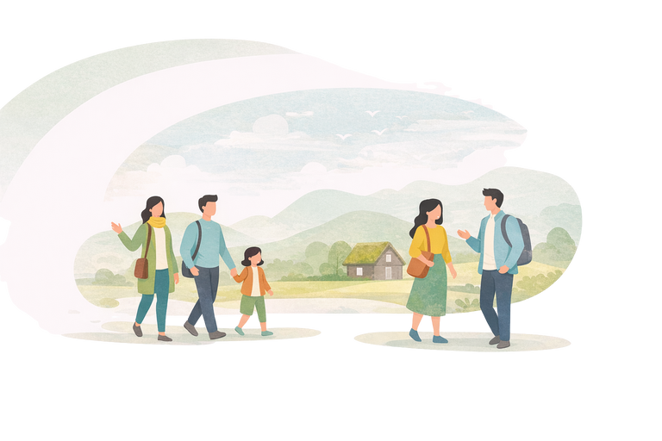
Welcome to (navnið á kommununi)
What is an information meeting
You are invited to an information meeting where you can receive guidance and ask questions about life in the Faroe Islands.
The meeting includes information about:
your local municipality and available services
language learning opportunities
work and education
activities and community life
your rights and responsibilities
The goal is to help you feel informed, supported, and welcomed in your new community.
Your municipal integration coordinator
Your municipal integration coordinator is your contact person to give guidance and support your everyday life settling in the Faroe Islands
Útlendingastovan
Tekningar: Vitlíki
Útgavan: 2026
www.utlendingastovan.fo
www.integration.fo

Slide 3
Stutt frágreiðing um kommununa
Stutt frágreiðing um kommununa
Hvar liggur kommunan (vísa á Føroyarkort)
Fólkatal
Stutt søga
Fakta um kommununa
Lokalar siðvenjur og mentan
Útlendingastovan
Tekningar: Vitlíki
Útgavan: 2026
www.utlendingastovan.fo
www.integration.fo

Slide 4

Tilboð (t.d. kommunal, heilsu. og trívnaðartilboð, o.a.)
Skriva eitt yvirlit yvir tilboð
Tað er umráðandi at vísa, hvar liggur kommunalæknin, hvørjar mannagongdir galda, upplatingartíðir, os.fr.
Útlendingastovan
Tekningar: Vitlíki
Útgavan: 2026
www.utlendingastovan.fo
www.integration.fo

Slide 5
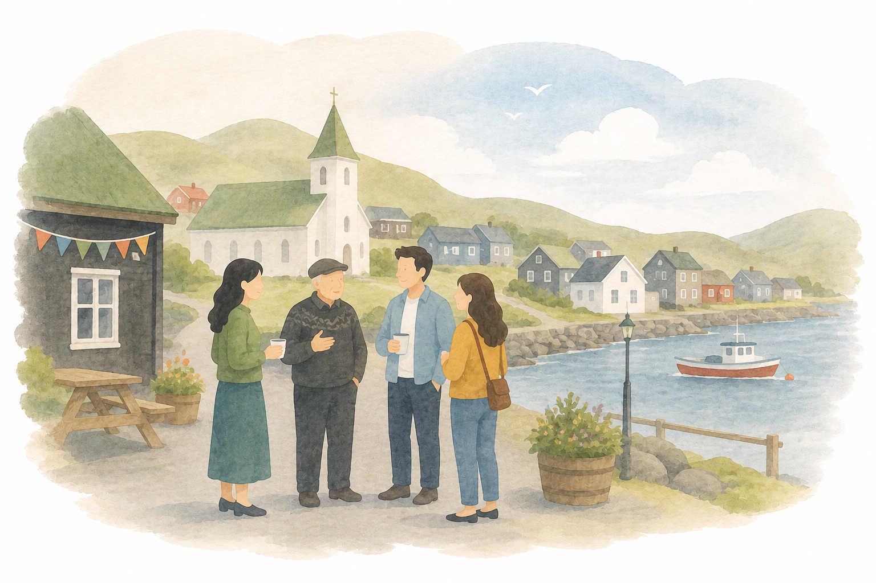
Festivalur og tiltøk
Útlendingastovan
Tekningar: Vitlíki
Útgavan: 2026
www.utlendingastovan.fo
www.integration.fo

Slide 6
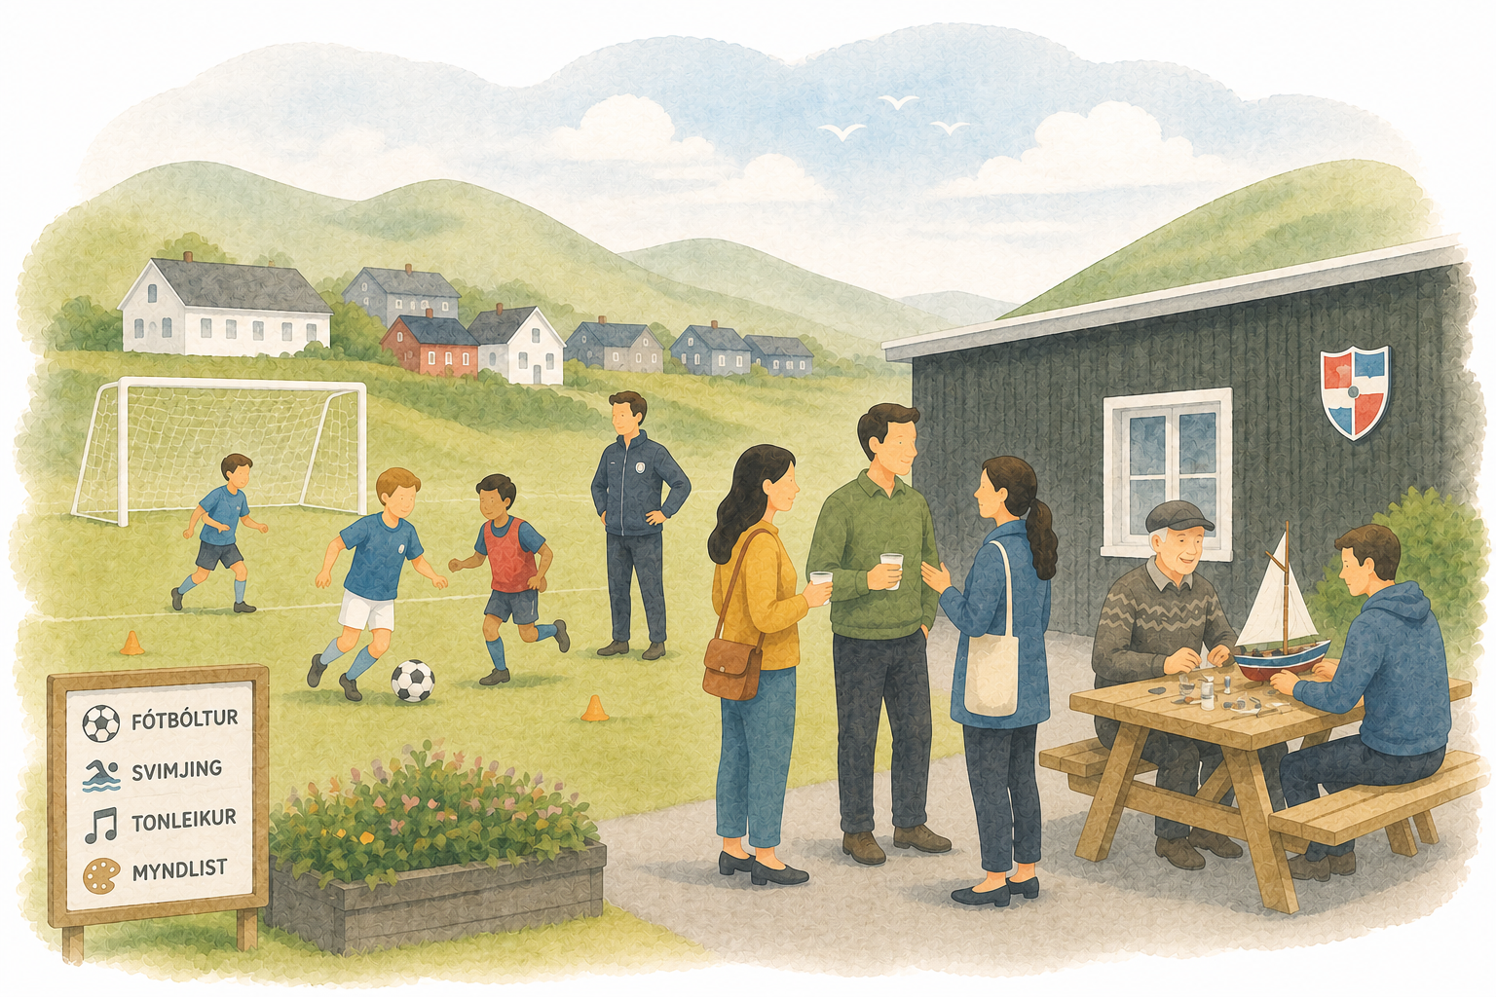
Ítróttur og felagsskapir
Minnist eisini til at greiða frá um, hvussu ein kann melda seg til ein ítrótt ella ein felagskap
Útlendingastovan
Tekningar: Vitlíki
Útgavan: 2026
www.utlendingastovan.fo
www.integration.fo

Slide 7
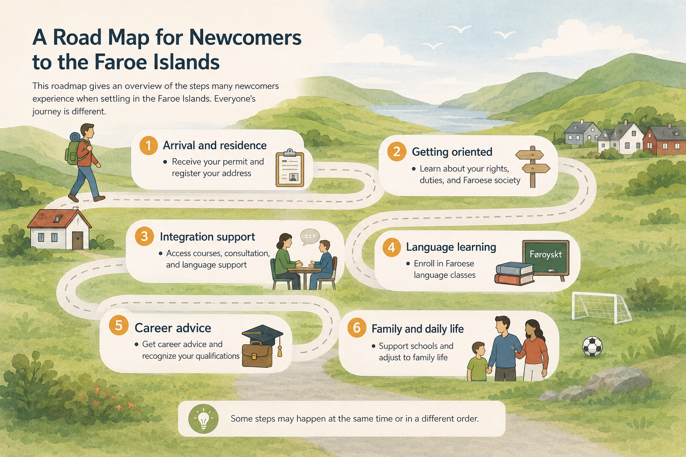

Slide 8



Types of Permits
To live and work in the Faroe Islands, you must first obtain a residence permit.
Below are some general information about the main types of permits that people usually apply for.
Let’s speak the same language
Temporary permits
Family reunification permit
Normally, a family reunification permit may be granted to the spouse, cohabiting partner, or minor children of a person residing in the Faroe Islands. The residing person is either in a relationship or married to a Faroese individual.
Work Permit
To work in the Faroe Islands, you must have found a job and a signed contract to apply for a work permit.
People often refer to a family visa or work visa, but in the Faroe Islands, the correct term is permit. Visa is used for short-term stays, whereas a family reunification permit or a work permit is intended for living and working in the country.
Accompanying family member permit
Family members of a work permit holder can apply for an accompanying family-member permit to live and work in the Faroe Islands, provided that the sponsor meets the financial support requirement.
Notes:
Gev gætur: Hendan slide er bert til kunning um sløg av uppihaldsloyvum. Um fólk hava spurningar ella tørv á vegleiðing, vísið tey til Útlendingastovan.

Slide 9
Permanent Residence Permits
A permanent residence permit allows you to live in the Faroe Islands indefinitely. You no longer need to renew your permit every year or continue meeting the requirements that applied to your original family reunification or work permit.
Permanent Residence permits
If you have a family reunification permit
Live continuously in the Faroe Islands for 3 years.
Pass a test in Faroese as a Second Language.
Attend an integration consultation and integration course.
Note.
The information provided about permits is general. It is important that you read the specific requirements for each type of permit. For more details, please visit www.utlendingastovan.fo
If you have a work permit
Live and work continuously in the same type of industry in the Faroe Islands for 7 years.
Pass a test in Faroese as a Second Language.
Attend an integration consultation and integration course.
Have no criminal record or significant public debt

Slide 10

Interpretation
Your Right to an Interpreter
How to Request an Interpreter
What an Interpreter Does
You have the right to ask for an interpreter when you need help understanding important information.
This applies to situations such as health appointments, conversations with schools, daycares, or other official discussions where you must fully understand what is being said.
Inform the person you will be meeting with as early as possible that you need an interpreter and which language the interpretation should be in.
Depending on the situation, interpretation may be provided free of charge. Please check beforehand who will pay.
Interpreter translate everything neutrally and confidentially.
They do not give opinions or advice.
Their role is to ensure accurate communication.
8

Slide 11

Integration Consultation
You can request a free integration consultation at the Integration Office. The consultation provides general information, advice and guidance related to settling in the Faroe Islands, as well as support in discussing your plans and possible next steps.
Interpretation will be used if you don’t understand Faroese or English.
Permanent Residence permits
Please remember
To be eligible to apply for a permanent residence permit, you must have done the following:
Passed Faroese as a Second Language
Attended in an integration consultation
Participated in integration course
We recommend that you complete these three requirements as soon as you received your permit.

Slide 12

Integration Course
The Integration Course is a free course offered by the Integration Office to newcomers who have received a residence permit in the Faroe Islands. The purpose of the course is to help you understand Faroese society, culture, everyday life along with your rights and responsibilities. By joining the course, you get useful knowledge that makes it easier to settle in, navigate public services, and take part in the community.
What you will learn
Faroese history and culture
Daily life, work, and traditions
Welfare system and public services
Children’s rights and education
Understanding laws and your responsibilities
Who is it for?
Any adult individuals who move to the Faroe Islands and fall under the Integration law will be invited to take the course. The program is organized by the Integration Office.
Our goal is to help you build a good foundation for life here, better understanding of Faroese society, and feel included and informed from the very beginning.

Slide 13


Family Course
If you are new to the Faroe Islands and have children or are expecting a child, you can join a free course designed to help you support your child’s growth learning, and well-being in a new country.
The course contains
Children’s rights
Language and development
Family dynamics and migration stress
What you will learn
Parenting in a new country can be different. This course helps you gain useful knowledge, connect with other parents, and become more confident as a parent in the Faroe Islands.
Parental well-being

Slide 14

Faroese as a second language
As a newcomer, you can take Faroese as a Second Language (FSA) courses to develop your Faroese language skills and better integrate into Faroese society. These courses are organized under the national framework for Faroese as a Second Language.
Benefits of attending
Improve your Faroese language skills
Better understand Faroese society and culture
Gain opportunities for further Faroese education
Practical Information
Free of charge
Courses last about four months
Available in three locations: Tórshavn, Kambsdali, and Vágur
For details and how to sign up, please go to www.uvs.fo

Slide 15
Búmerki
Útlendingastovan
Immigration and Integration Office
Skálatrøð 20
Postrúm 264
FO-110 Tórshavn
Føroyar
+298 357979
info@utlendingastovan.fo
Skriva upplýsingar um kommununa her.
All Content Copyright © 2026
Útlendingastovan

