Slide 1
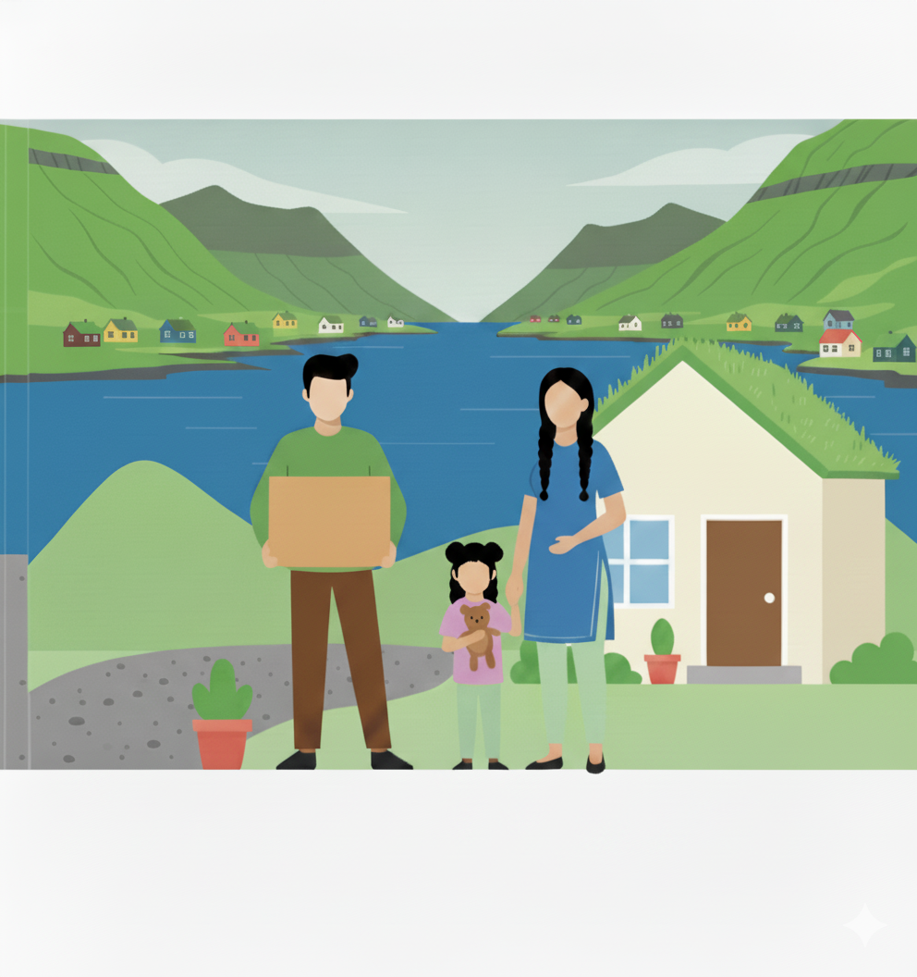

Welcome to the Faroe Islands

Slide 2
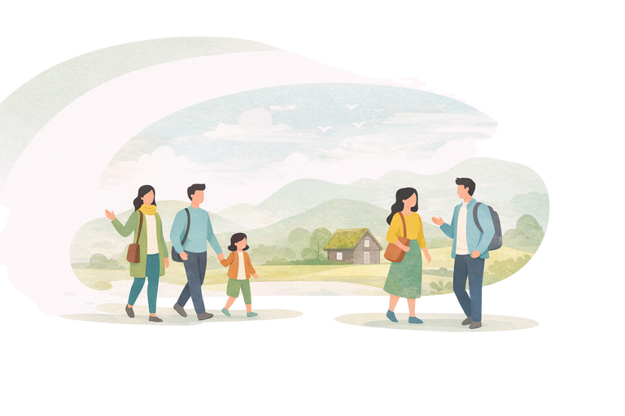
Welcome to (navnið á kommununi)
Stutt frágreiðing um kommununa
  Hvar liggur kommunan (vísa á Føroyarkort)
  Fólkatal
  Stutt søga
  Fakta um kommununa
  Lokalar siðvenjur og mentan
  Tilboð (t.d. kommunal, heilsu. og trívnaðartilboð, o.a.)
  Festivalur og tiltøk
  Ítrøttur og felagsskapir
Útlendingastovan
Tekningar: Vitlíki
Útgavan: 2026
www.utlendingastovan.fo
www.integration.fo

Slide 3
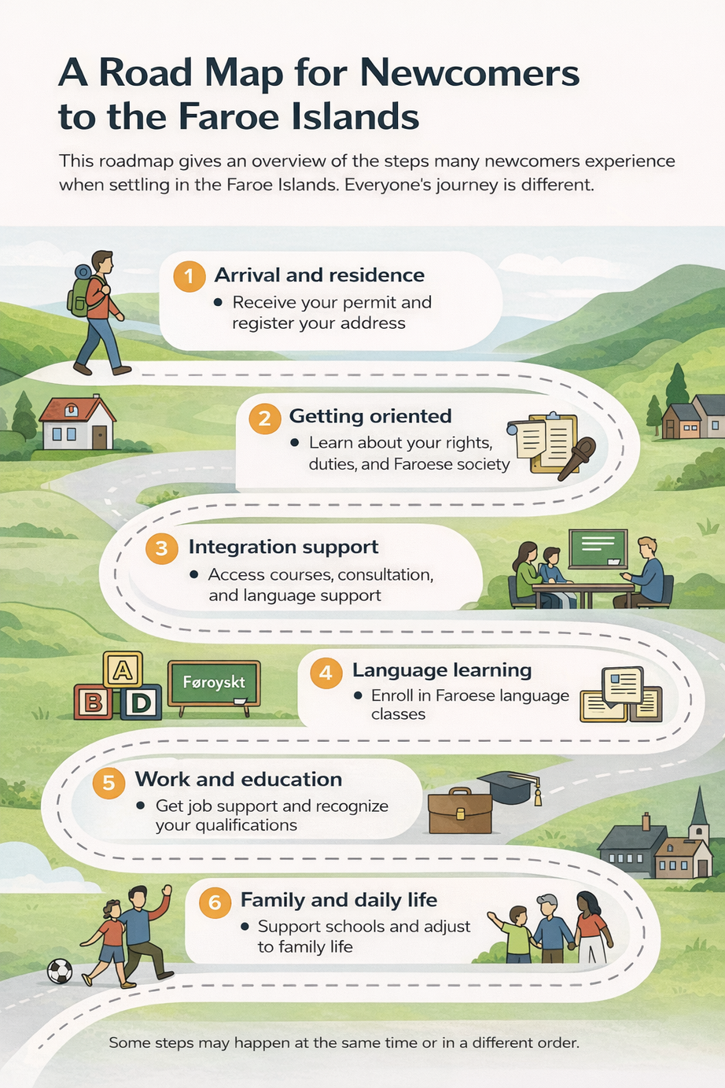

Slide 4





Permits
To live and work in the Faroe Islands, you must first obtain a residence permit.
Below are some general information about the main types of permits that people usually apply for.
Let’s speak the same language
Temporary permits
Family reunification permit
Normally, a family reunification permit may be granted to the spouse, cohabiting partner, or minor children of a person residing in the Faroe Islands. The residing person is either in a relationship or married to a Faroese individual.
Work Permit
To work in the Faroe Islands, you must have found a job and a signed contract to apply for a work permit.
People often refer to a family visa or work visa, but these terms don’t officially exist. The word visa generally refers to permission to enter a country — for example, some countries require you to apply for a tourist visa before arrival. A permit, on the other hand, authorizes you to live and work in a country for a longer period.
Accompanying family member permit
Family members of a work permit holder can apply for an accompanying family-member permit to live and work in the Faroe Islands, provided that the sponsor meets the financial support requirement.

Slide 5






Permits
A permanent residence permit allows you to live in the Faroe Islands indefinitely. You no longer need to renew your permit every year or continue meeting the requirements that applied to your original family reunification or work permit.
Permanent Residence permits
If you have a family reunification permit
    Live continuously in the Faroe Islands for 3 years.
    Pass a test in Faroese as a Second Language.
    Attend an integration course and integration consultation.
Holders of family reunification or work permits must meet certain requirements to be eligible for a permanent residence permit.
If you have a work permit
    Live and work continuously in the same type of industry in the Faroe Islands for 7 years.
    Pass a test in Faroese as a Second Language.
    Attend an integration course and integration consultation.
    Have no criminal record or significant public debt
Note.
The information provided about permits is general. It is important that you read the specific requirements for each type of permit. For more details, please visit www.utlendingastovan.fo

Slide 6



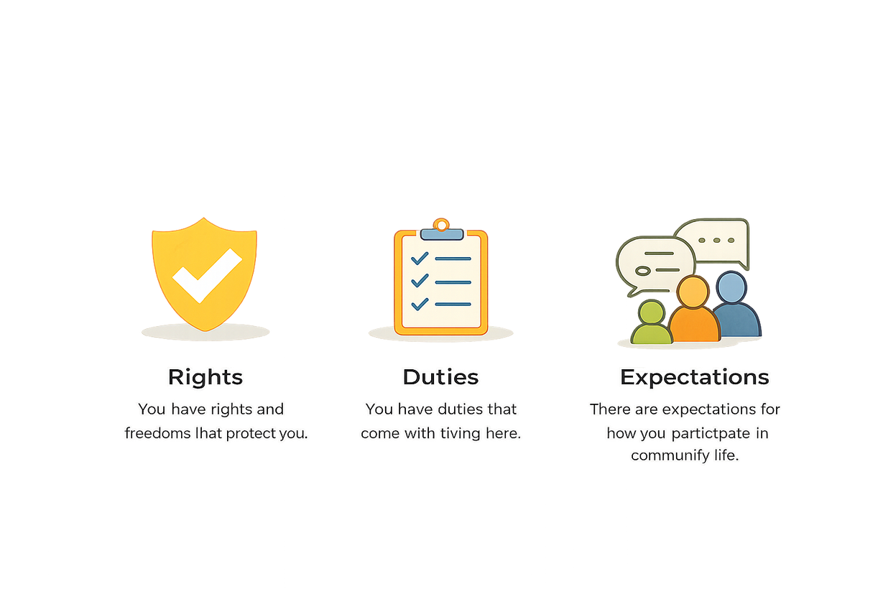
Rights, Duties, and Expectations of You
As a newcomer with a residence permit in the Faroe Islands, it is important to become familiar with your rights, duties, and the expectations placed upon you.
This helps you feel safe, respected, and prepared to build a new life here.
You have rights and freedoms that protect you.
The Faroe Islands is a democratic welfare society. This means that everyone has rights, responsibilites, and shared expecations.
You have duties that come with living here.
There are expectations for how you participate in community life.

Slide 7
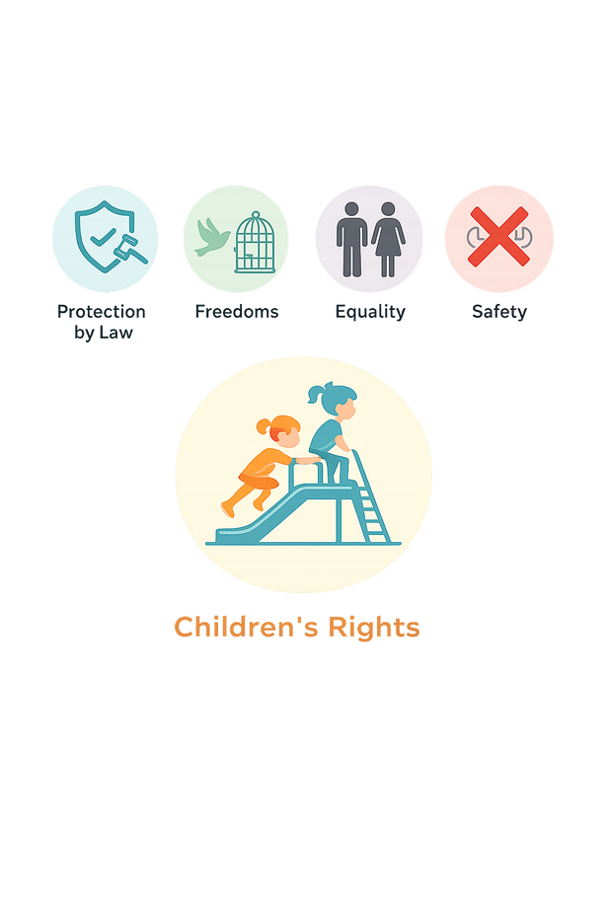


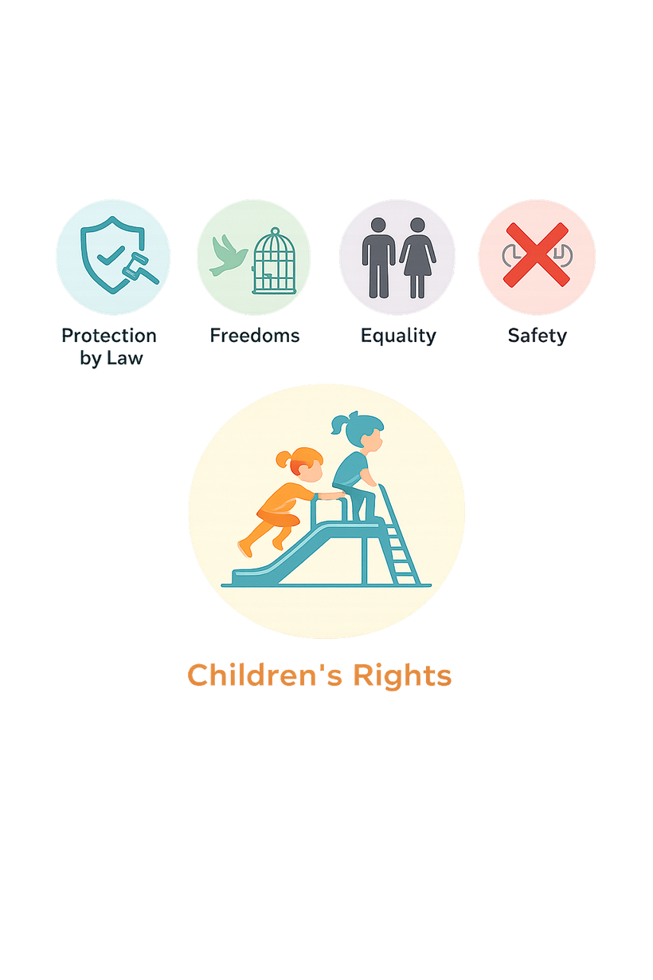
Your Rights
Your rights are the freedoms you have and the support you can receive while living here. They ensure access to health care, education, fair treatment, and participation in society.
Protection by law
Freedoms
Everyone is protected by Faroese law, the Danish constitution, and by international human rights.
You have freedom of speech, religion, opinion, and association.
Children’s Rights
Children have the right to receive an education, learn Faroese and Danish, maintain and use their mother tongue, be heard, receive information, play and feel safe. Physical and emtional abuse is illegal. Parents are responsible for their children’s care, safety, and development.
Gender Equality
Safety
All people—men, women, boys, and girls—must be treated equally.
Physical, psychological, financial, or emotional abuse is illegal and not tolerated. You should never have to live in fear.

Slide 8



Your Rights (continued)
Marriage Equality
Voting Rights
Same-sex couples have equal rights to marry and raise families.
After living in the Faroe Islands for 3 years in a row, you can vote and run as a candidate in municipal elections.
Social Rights
Social rights include access to public services when needed, such as health care, education, and financial support. Some financial services may depend on your type of residence permit and could affect your permit status negatively — always ask if you are unsure.
Family and Private Life
Personal Information
You have the right to family life and personal privacy.
You have the right to ask public institutions for information about your own case or other matters related to your inquiry.

Slide 9
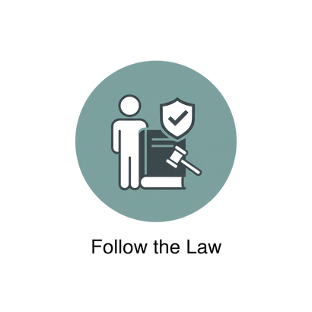
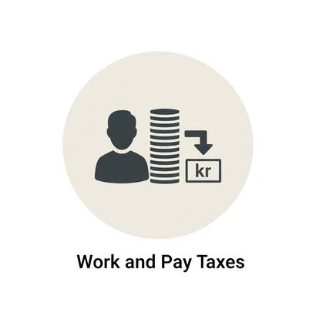
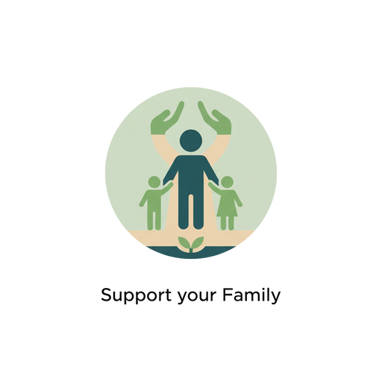

Your Duties
Your duties are the responsibilities you have while living here. They are about respecting others, following the law, and contributing to the welfare society.
Follow the Law
Work and Pay Taxes
Everyone must respect Faroese laws, treat others with dignity, and reject violence and discrimination. Report illegal activity and seek help if your rights are violated.
The welfare system is built on shared responsibility. If you can work, you are expected to contribute. You have a duty to pay taxes on your income. Working without paying taxes is illegal.
Support Your Family
Compulsory Education
If you are married and/or have children, you are responsible for their financial support.
Education for children is compulsory for nine years starting from the year the child turns seven. You have a duty to ensure that your child receives an education.
6

Slide 10
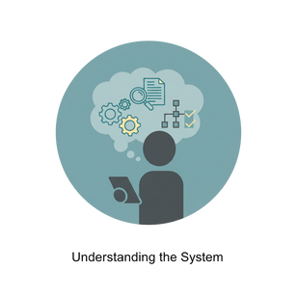


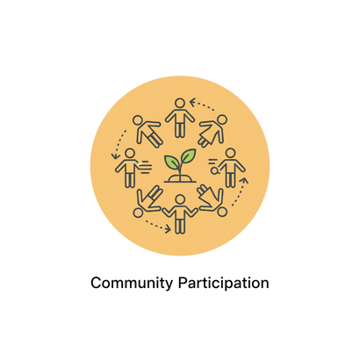
Expectations of You
As part of your integration process, you are expected to take part in Faroese society, and you are welcome to maintain your own cultural identity. These expectations support your ability to settle, thrive, and eventually apply for permanent residence.
Understanding the System
Respect Democratic Values
You are expected to learn how the political, welfare, and education systems work. This helps you manage daily life and become more self-reliant and independent.
You are expected to respect and embrace freedom, democracy, equality, and diversity as the foundation for peaceful living.
Take Part in Society
Community Participation
You are expected to learn about Faroese culture and traditions, and to join local life through activities you enjoy such as clubs, sports, events, or by meeting new people. Having a personal network is important in a small community. You are encouraged to share your own culture and traditions and be open to others.
Even if you do not have citizenship or voting rights, you still have the right to take part in a democratic society by sharing your opinions, joining conversations, and becoming part of local groups or associations to feel more connected and to make a difference. As a member of a democratic society, you are encouraged to use this right.

Slide 11

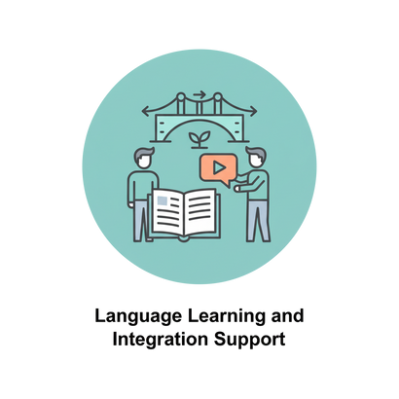
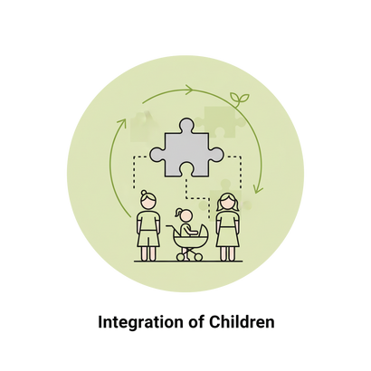
Expectations of You (continued)
Language Learning
& Integration Support
Integration of Children
You have the right to free Faroese language classes, integration course, parenthood course, and an integration consultation. If you plan to apply for permanent residence, you are expected to attend these sessions under the new Integration Law. English may help you with at first, but Faroese is essential for building connections, finding work, and becoming independent.
As a parent, you are responsible for the integration and well-being of your children, with support from Faroese society. This means helping your children learn the Faroese language, supporting their education and school participation, attending parent-teacher meetings, attending the free parenthood course, signing them up for sports and leisure activities, and helping them to build friendships with other children. These efforts help your children feel included, succeed in school and become part of the community.

Slide 12


Interpretation
Your Right to an Interpreter
How to Request an Interpreter
What an Interpreter Does
You have the right to ask for an interpreter when you need help understanding important information.
This applies to situations such as meetings about your residence, health appointments, conversations with schools, daycares, or other official discussions where you must fully understand what is being said.
  Inform the person or service as early as possible and language
  In most cases, interpretation is provided free of charge.
  Interpreter translate everything neutrally and confidentially.
  They do not give opinions or advice.
  Their role is to ensure accurate communication.
  Clear communication helps you make good decisions and understand your rights and responsibilities.
8

Slide 13




Integration Consultation
You can request a free integration consultation at the Integration Office. The consultation provides general information, advice and guidance related to being a new resident in the Faroe Islands and also discuss your future plans and what steps can be made.
Interpretation will be used if you don’t understand Faroese or English.
Permanent Residence permits
Please remember
In order to be eligible to apply for a permanent residence permit, you must have done the following:
    Passed Faroese as a Second Language
    Attended in an integration consultation
    Participated in integration course
We recommend that you complete these three requirements as soon as you received your permit.

Slide 14



Integration Course
The Integration Course is a free course offered by the Integration Office to newcomers who have received a residence permit in the Faroe Islands. The purpose of the course is to help you understand Faroese society, culture, everyday life and important rights and responsibilities. By joining the course, you get useful knowledge that makes it easier to settle in, navigate public services, and take part in the community.
What you will learn
    Faroese history and culture
    Daily life, work, and traditions
    Welfare system and public services
    Children’s rights and education
    Understanding laws and your responsiblities
Who is it for?
Any adult individuals who move to the Faroe Islands and fall under the Integration law will be invited to take the course. The program is organized by the Integration Office.
Our goal is to help you build a good foundation for life here, better understanding of Faroese society, and feel includedand informed from the very beginning.

Slide 15



Family Course
If you are new to the Faroe Islands and have children or are expecting a child, you can join a free course desinged to help you support your child’s growth learning, and well-being in a new country.
What you will learn
Everyday routines and schools
Language and development
Health services and safety
What you will learn
Parenting in a new country can be different. This course helps you gain useful knowledge, connect with other parents, and become more confident as a parent in the Faroe Islands.
Parenting in the Faroe Islands

Slide 16



Faroese as a second language
As a newcomer, you can take Faroese as a Second Language (FSA) courses to develop your Faroese language skills and better integrate into Faroese society. These courses are organized under the national framework for Faroese as a Second Language.
Benefits of attending
    Improve your Faroese language skills
    Better understand Faroese society and culture
    Gain opportunities for further Faroese education
Practical Information
    Free of charge
    Courses last about four months
    Available in three locations: Tórshavn, Kambsdali, and Vágur
For details and how to sign up, please go to www.uvs.fo

Slide 17

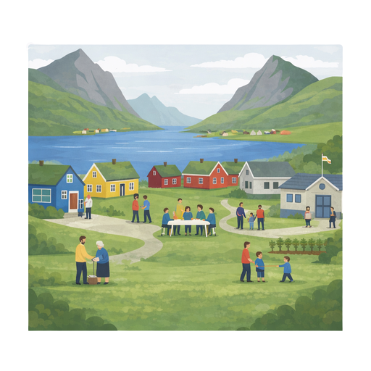
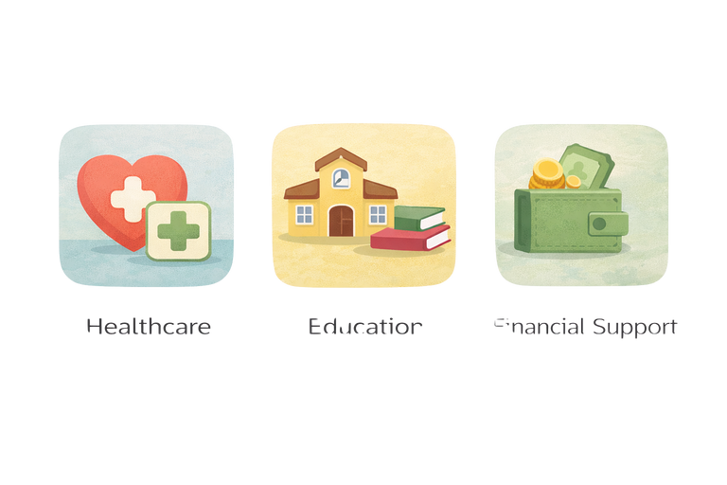
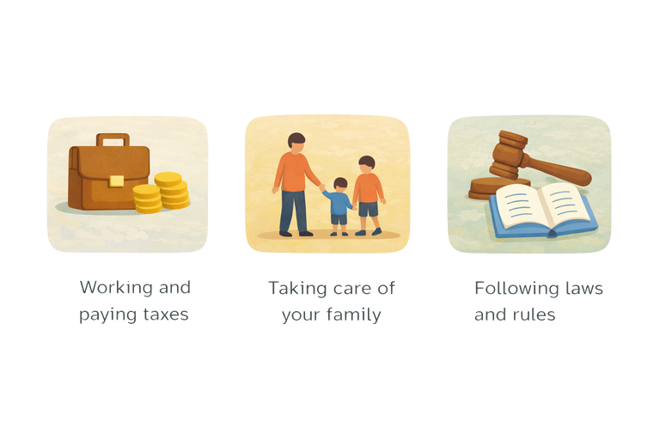
Welfare system
The welfare system is based on the idea that the community works together to make sure everyone has access to basic services and support. These services are mostly paid for through taxes, which all residents contribute to.
Maintaining a strong welfare society makes the Faroe Islands a better place for everyone.
Examples of Welfare Services and Support
Access to healthcare services for all
Free access to education
Assistance during difficult times
What is expected from everyone
Working and paying taxes
Taking care of your family
Following laws and rules

Slide 18



Education
Education is highly valued in the Faroe Islands and is available to both children and adults. Most education is free, and the system is flexible, allowing people to change paths, gain new skills, or continue to higher education later in life.
Education for Adults
  Faroese as a Second Language (FSA) courses for adults, offered free of charge.
  Short introductory Faroese courses offered by municipalities for a fee.
  Adult education and training program that allows you to gain new skills, change careers, or qualify for further education.
No matter your background, there are options to help you continue learning, strengthen your skills, and build your future in the Faroe Islands.
Vegleiðingarstovan
Velgleiðingarstovan provides free consultation and counselling on both education and job opportunities. Whether you hold an education or not, Vegleðingarstovan can work with you on finding your next steps.

Slide 19





Your next steps
Starting a new life in the Faroe Islands can feel overwhelming, but remember, support is available to guide you through this journey.
Your Support
Útlendingastovan has integration counselors you can contact for advice and support.
Municipal integration coordinators are also available locally to answer questions and provide guidance.
Your next steps
Don’t feel like you are alone in this journey. Many others have gone through similar experiences. Be open and talk with others about your challenges and struggles.
  Take time to sightsee and participate in local events and festivals.
  Ask a local about clubs or groups that reflect your hobbies or interests.
  Learn some Faroese before starting work (learning the basics can help a long way.)
  Ask for guidance about education recognition if you hold non-Nordic higher education degree.
  Be proactive when job hunting; don’t hesitate to call or visit potential employers in person.

Slide 20


Útlendingastovan
Immigration Office
Skálatrøð 20
Postrúm 264
FO-110 Tórshavn
Føroyar
+298 357979
info@utlendingastovan.fo
All Content Copyright © 2026
Útlendingastovan

